Slide 1
MLIP Team 7
Final Presentation
Presented by
Po-Chun Chen, Jiahao Guo, Anushka Bhave, Shun Li, Gilbert Wu

Slide 2
Overview

Slide 3
Project Overview
GOAL
Build a production-ready, scalable, and fair recommendation system that adapts to real-time data, supports experimentation, and ensures reliability across all components.
Dataset
Streaming platform with 1M users and 27K movies
Real-time behavior data: watch logs, page visits, ratings via Kafka
Metadata includes user profiles (age,gender) and movie info (genres, popularity)
MODEL
Models: SVD, Collaborative Filtering and KNN. MLflow for experiment tracking and retraining
Conducted offline evaluation, online A/B testing, and fairness analysis to assess recommendation quality and demographic bias

Slide 4
Design Choice

Slide 5
Key Design Choices
VM-based Training & Monitoring
Entire ML pipeline deployed on a single virtual machine
Enabled centralized debugging and iteration of all pipeline components
PostgreSQL for Data Management
All processed data and metadata stored in a PostgreSQL database
Simplified structured queries and integration with downstream components
Containerization via Docker
Docker ensured consistent environments across team members
Used `docker-compose` for orchestration of Prometheus, Grafana, and pipeline components

Slide 6
Workflow

Slide 7
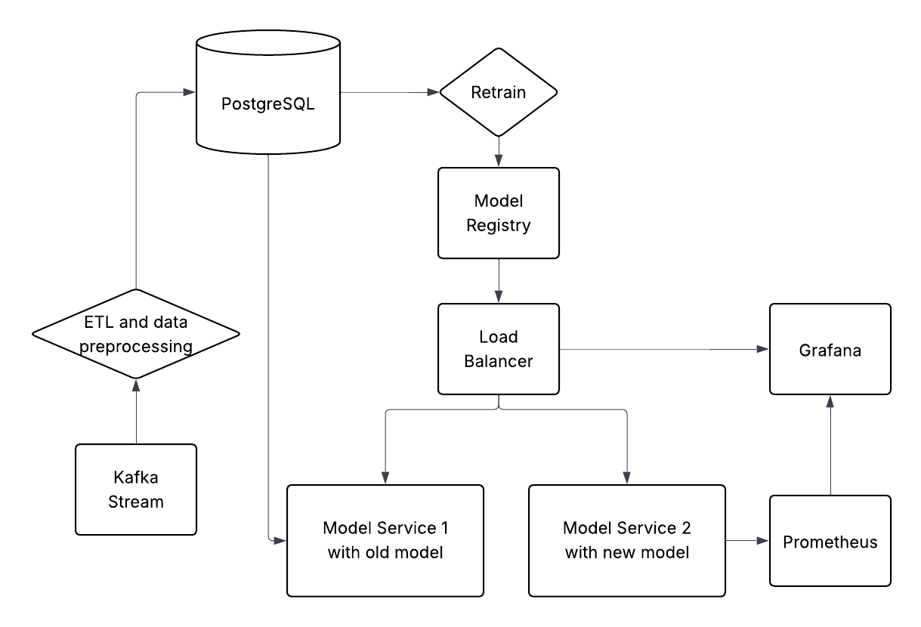
Workflow
Notes:
Let me walk you through our workflow from data to model deployment. Everything starts with a real-time data stream coming in through Kafka. That data goes through ETL and preprocessing, where we clean and format it so it’s ready to be used. After that, the processed data is stored in PostgreSQL, which acts as our main database.
From there, we can either serve predictions using our existing models or kick off retraining when there's enough new data or performance starts to drop. Once we retrain, the new model gets registered in our model registry — this is where we keep track of model versions.
The load balancer then manages traffic and routes incoming requests to either the old model or the newly trained one. We run both in parallel so we can test the new model while keeping the old one live — just in case.
Finally, we use Prometheus to collect metrics from both models, and Grafana helps us visualize everything — so we can monitor performance and spot any issues quickly.
This setup gives us a reliable, flexible pipeline that supports continuous model improvement while keeping production stable.

Slide 8
Technical Challenge

Slide 9
Technical Challenges
Containerizing, Monitoring, CI/CD
Integrating Jenkins-based CI/CD with containers and monitoring was challenging due to tool interdependence
Security
A peer breach prompted us to enforce user roles, secure credentials, and configure firewalls

Slide 10
Reflection & Future work

Slide 11
Reflection & Future Works
Build for Continuous Updates from the Beginning: Design the system to support seamless model updates, A/B testing, version control, and easy rollbacks to ensure smooth deployment of new recommendation algorithms
Embed Observability Early On: Integrate logging, metrics, and real-time alerting frameworks early to monitor recommendation quality, user engagement, and system health proactively.
Adopt a Service-Oriented Architecture: Decouple modules like data ingestion, model training, recommendation engine, and user feedback loop into independent services to enable easier maintenance and scaling.
Expect and Handle Failures Gracefully: Anticipate scenarios such as data pipeline breaks, cold-start problems, or shifts in user preferences, and implement safeguards to detect, adapt, and recover automatically.

Slide 12
Thank you!

